Slide 1

HDB RESALE FLAT
Looking to buy/sell your HDB property?
Notes:
Who am I presenting to?
Interested Buyers and Sellers
Buyers - bang for buck
Sellers - what makes their flat worth more?

Slide 2

OUR COMPANY
A one-stop solutions company to match your expectations to your dream HDB home.
Notes:
Who are we? Credentials?
We’ve been in the real estate for XX months and we’ve successfully matched buyers to sellers at a (baseline score - accuracy).

Slide 3
OUR THOUGHT PROCESS
COLLECTION
CLEANING
FEATURE ENGINEERING
UNDERSTANDING
VISUALISING
PRE-PROCESSING
MODELLING
DEPLOYMENT
ANALYSIS

Slide 4
NOW
Collection, Cleaning and Feature Engineering

Slide 5
COLLECTION, CLEANING AND FEATURE ENGINEERING
Our information is collected from Data.gov.sg. Below are the information from the database that we used to create this application:
HDB Property Information
Resale Flat Prices
Schools
MRT
Supermarkets
Hawker Centres
HDB Resale Price Index

Slide 6
DATA COLLECTION, CLEANING AND FEATURE ENGINEERING
To make our application, we selected features that are important to a buyer/seller when it comes to purchasing or selling their homes. In that process, we have:
Dropped miscellaneous and irrelevant columns
Removed duplicates, number of resale flats in each block and perfectly correlated features
Creating an ‘address’ column (combining block and road) or using postal code to find latitude and longitude
HDB flats, Primary/Secondary School, Pre-school, MRT, Supermarkets, Hawker Centres, Malls/Major Attractions
Finding distances between each block and the nearest feature above
Created a column to identify features that lie within 1km and 5km distance from the flat
Recalculated remaining lease on resale flats
Dummifying categorical columns
Combining all data after cleaning into one dataframe called df_dum

Slide 7
NOW
Understanding and Visualising

Slide 8
UNDERSTANDING AND VISUALISING
We used Pandas Profiling and Matplotlib to understand and visualise our garnered data. To calculate the distances, we used the geodesic distances.
Note: the distances quoted are in meters in absolute distances rather than distance (utilised in navigation maps and taking into consideration traffic).
Read more about Geodesic: https://mathworld.wolfram.com/Geodesic.html

Slide 9
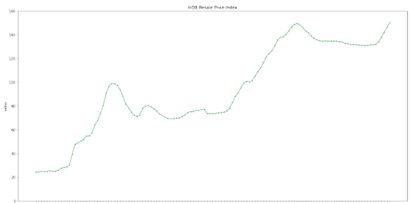
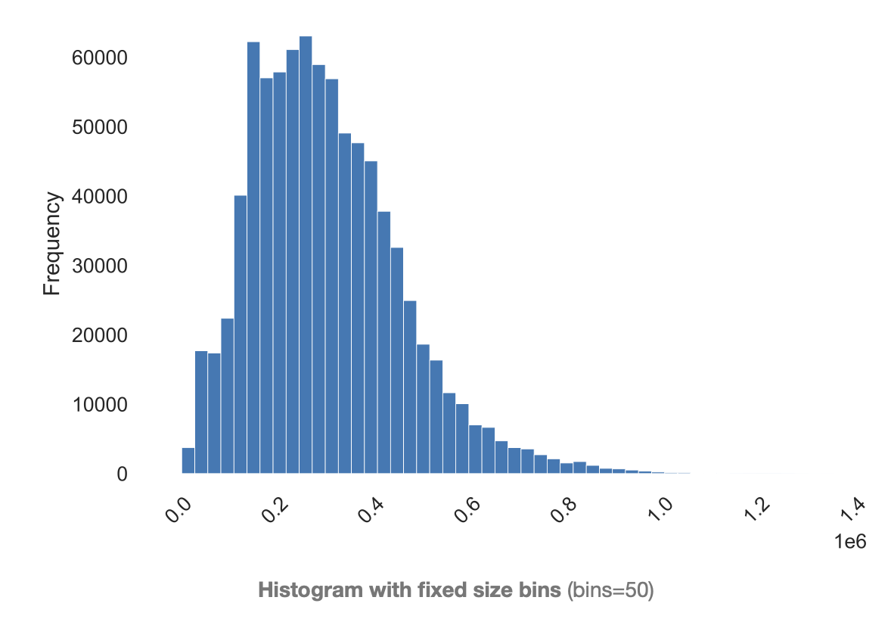
trend: resale price index
Due to rising demand in housing, there is a steady increase in resale flat prices over the years. Our data spans from Quarter 1 of 1990 (1990Q1) to Quarter 3 of 2021 (2021Q3).

Slide 10
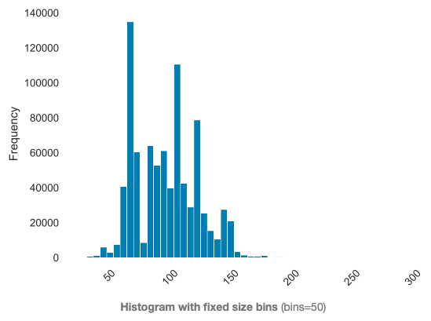
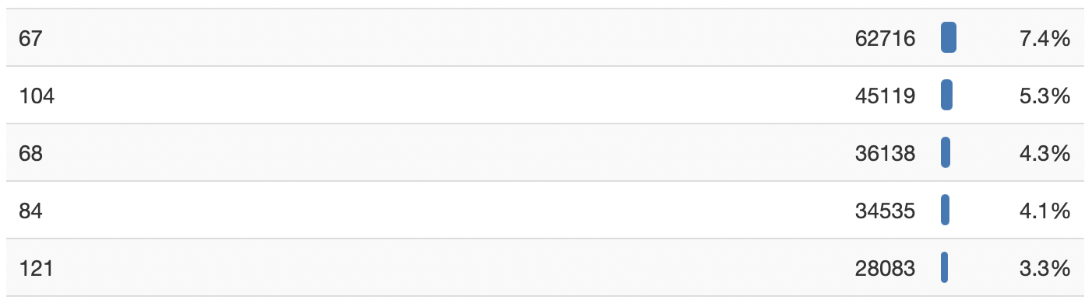
floor square area
Floor square area of the HDB units has a right-skewed distribution
75% of the flats are sized less than 115 square metres.
As HDB has many naming conventions and layouts e.g. a five room flat may be smaller than a four room flat.
In some newer layouts, it may be better to base it on floor area.

Slide 11
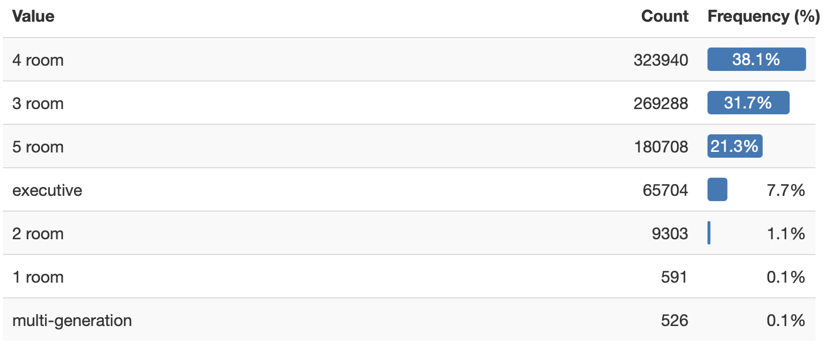
number of flat models
Most flats that were sold since 1990 were 4-room flats, with the least being multi-generational homes.
4-room flats are a comfortable size for most families as these have 3 bedrooms, and families can upsize to a bigger flat in future if they need to.

Slide 12
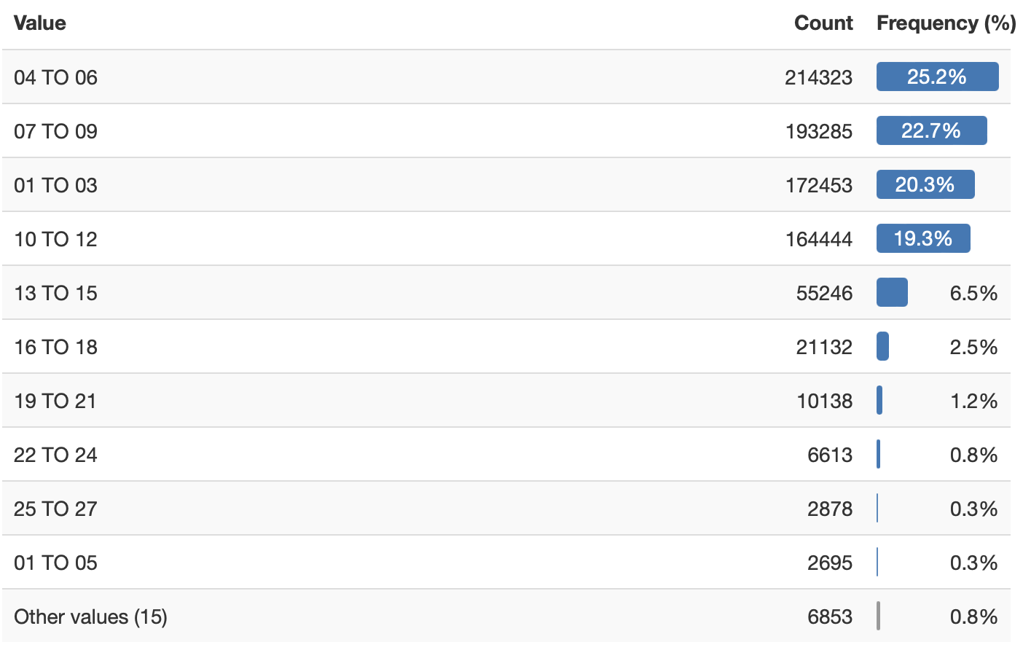
storey range
Most houses sold between 1990 and 2021 are on storeys below 13.
This means that there is always a constant supply of houses within that storey range.
It may be harder to find flats in storeys on 13 and higher.
Since there is a lower supply of flats on higher floors, demand and price may be higher.

Slide 13
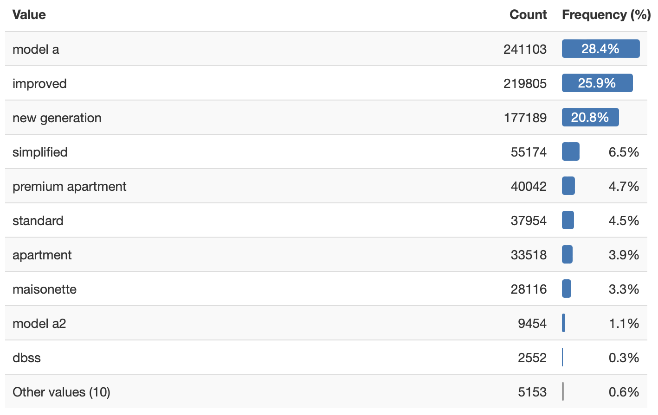
distribution of flat types
Model A is the most common across all HDB flat sizes, followed by Improved.
Model A units built in 1980s have a refuse chute in the kitchen. From 1990s, centralised refuse chutes were built.
Standard and Improved flat types are the oldest flat types. They are slowly being phased out through en bloc.
Meanwhile, DBSS flats are no longer built since 2012 as the scheme has been suspended.
Read more about HDB flat types here: https://www.teoalida.com/singapore/hdbflattypes/
Notes:
3-Room Model A (1982-1989) - refuse chute in the kitchen
1, 2, 3 Room Improved (1960s) - older models, created 6 years after the standard, undergo enbloc

Slide 14

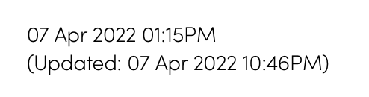
IN THE NEWS
These blocks in Ang Mo Kio are ‘new generation’ flats. Exactly how old are these flats?
4 HDB blocks in Ang Mo Kio identified for SERS; first such announcement in nearly 4 years: https://www.channelnewsasia.com/singapore/hdb-sers-ang-mo-kio-en-bloc-new-flats-2613516
Notes:
3-Room Model A (1982-1989) - refuse chute in the kitchen
1, 2, 3 Room Improved (1960s) - older models, created 6 years after the standard, undergo enbloc

Slide 15
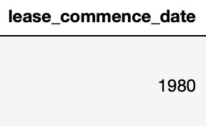
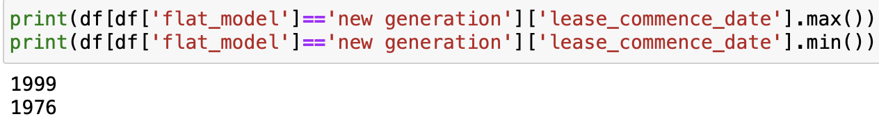
IN THE NEWS
Turns out, these blocks in Ang Mo Kio are ‘new generation’ flats. Exactly how old are these flats?
All of the blocks affected have leases starting in 1980 (except for block 564 which starts in 1985).
When we find out how old are ‘new generation’ flats, they were available for lease from 1976 to 1999! After Standard, Improved and Model A, it is no wonder that New Generation flats are the next flats to be considered for en bloc.
4 HDB blocks in Ang Mo Kio identified for SERS; first such announcement in nearly 4 years: https://www.channelnewsasia.com/singapore/hdb-sers-ang-mo-kio-en-bloc-new-flats-2613516
Notes:
3-Room Model A (1982-1989) - refuse chute in the kitchen
1, 2, 3 Room Improved (1960s) - older models, created 6 years after the standard, undergo enbloc

Slide 16
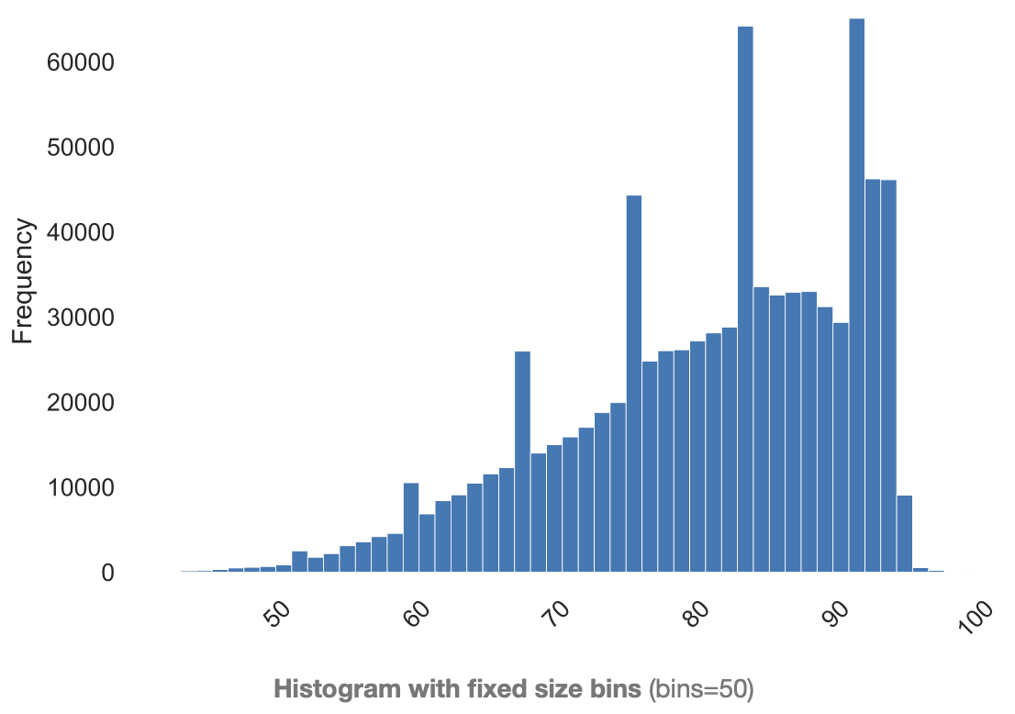
remaining lease (in years)
There were multiple features that had perfect collinearity - lease commencement date and the year the property was sold. A new feature was added to calculate the remaining lease (in years) as HDB flats have a 99-year lease. In general, we would think that the price of the flat will decrease as the number of years remaining reduces.
For those looking for a centralised refuse chute, do look out for remaining lease of at least 68 years, as flats built from 1990s do not have refuse chutes in the kitchen.
Read more about HDB flat types here: https://www.teoalida.com/singapore/hdbflattypes/

Slide 17
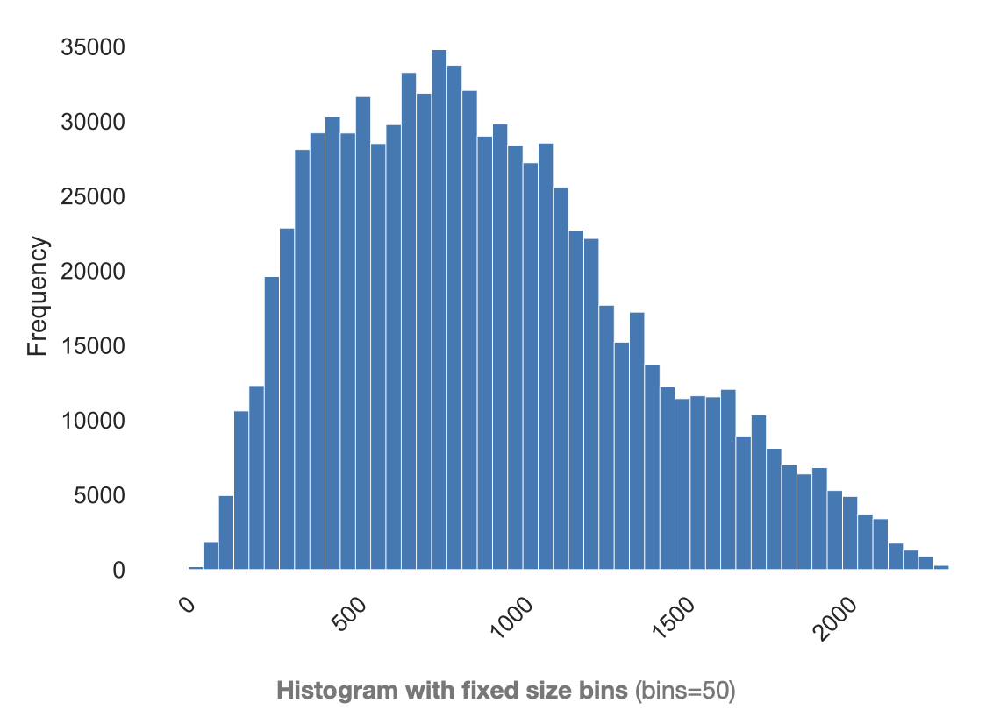
minimum distance to major attractions
In the source data, major attractions included shopping malls and prominent hotels such as Marina Bay Sands. Our key focus is on shopping malls, where amenities such as the post office and banks would most likely be present.
On average, HDB resale flats are located 925m away from ‘major attractions’ (defined as shopping malls)
The 50th percentile is located 863m and 75th percentile are located 1224km from the nearest shopping mall.
The distribution is right skewed, with a skewness of ~0.538.

Slide 18
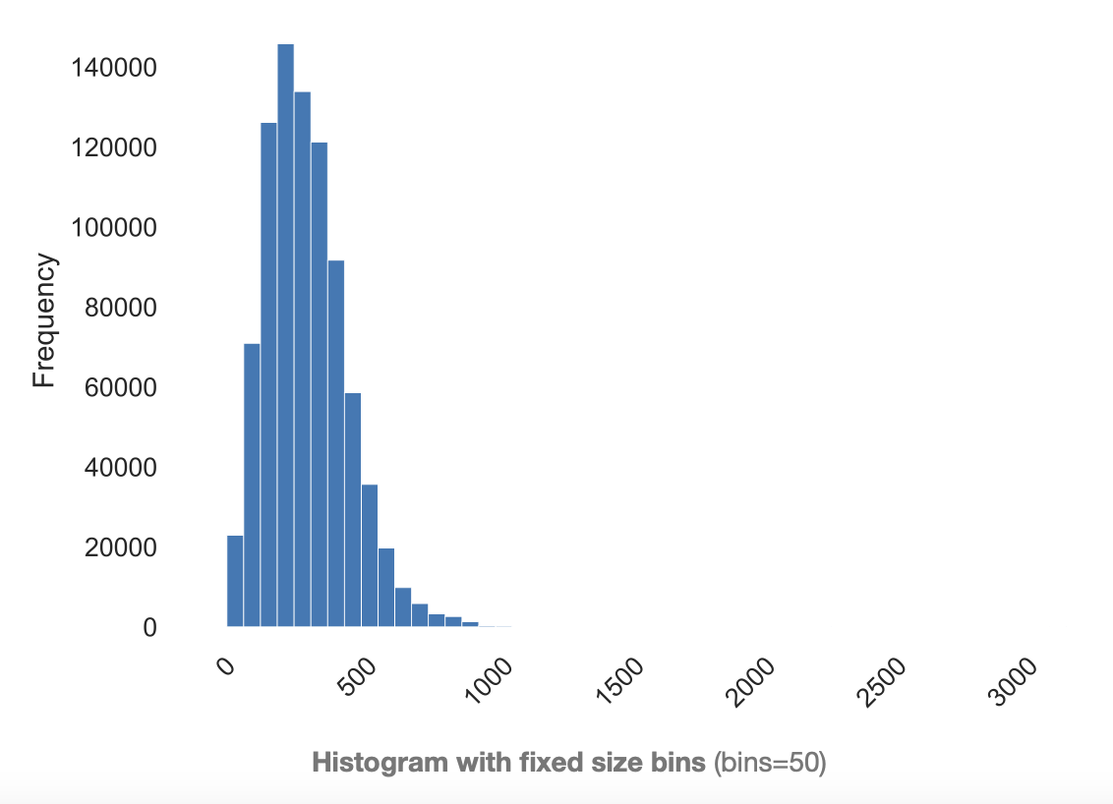
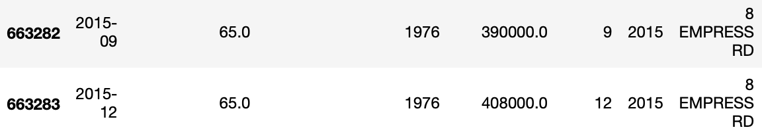
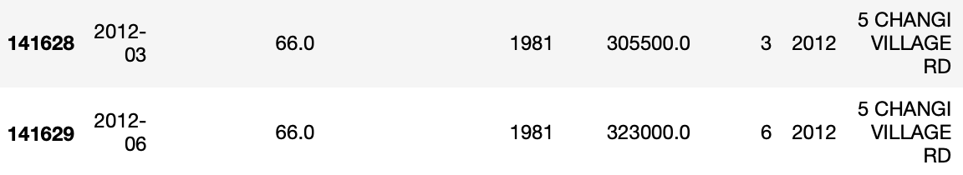
minimum distance to supermarket
Carrying groceries over long distances may not be ideal for many, and having a supermarket nearby adds convenience.
The data available on data.gov.sg does not list down available wet markets, which describes the extreme right-tail.
Right-skewed~1.88

Slide 19
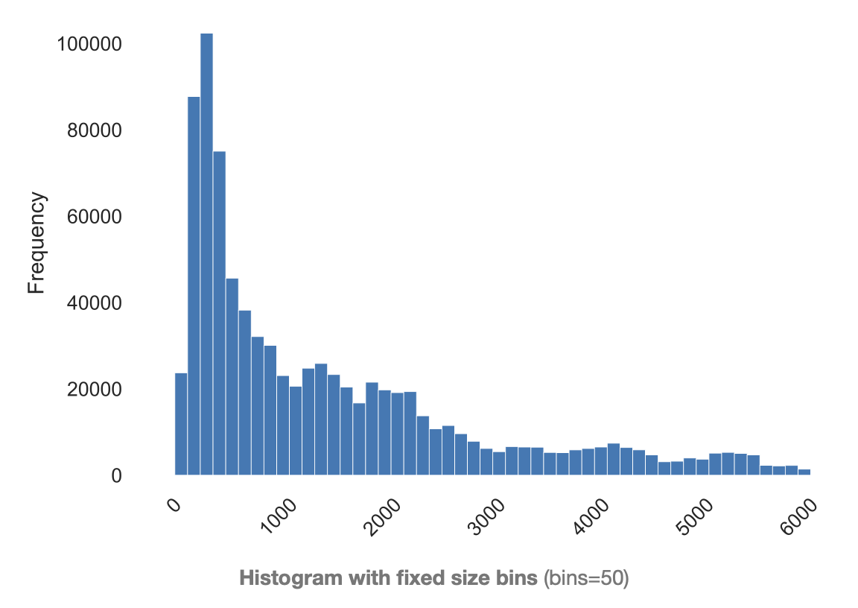
minimum distance to open-air hawker centres
Hawker fare is one of the key highlights of living in Singapore. Offering cheap, affordable food, it helps residents keep costs of living low even when eating takeout food.
75th percentile are situated within 2118m of the nearest hawker centre.
After analysing HDB flats located further away from hawker centres, they generally fall in either of these categories:
Near shopping mall
In newer estates (Fernvale, Compassvale, Edgefield, Bukit Batok West)
Far away from MRT, but have void deck coffeeshops (Bukit Batok)
Near LRTs (Bukit Panjang)

Slide 20
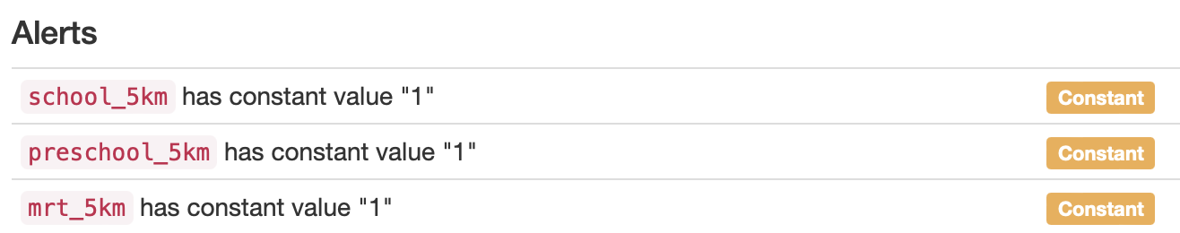
Fun Fact:
All HDB flats are located within 5km radius of a primary/secondary school, pre-school and MRT station!

Slide 21
Secondary/Primary School
99.4% are located within 1km radius
Pre-School
99.9% are located within 1km radius
MRT station
76.6% are located within 1km radius
1km Radius

Slide 22
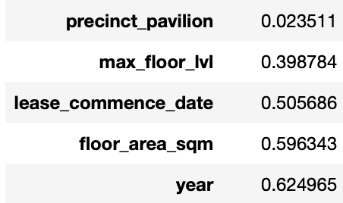
correlation coefficients
These are the top 5 features that positively correlate with resale price.
These are the general findings:
Bigger floor square area command higher prices
The younger the flat, the higher the prices
A taller flat will slightly command higher prices
The availability of a pavilion slightly pushes prices higher

Slide 23
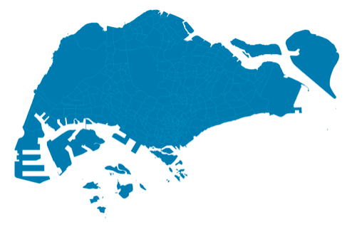
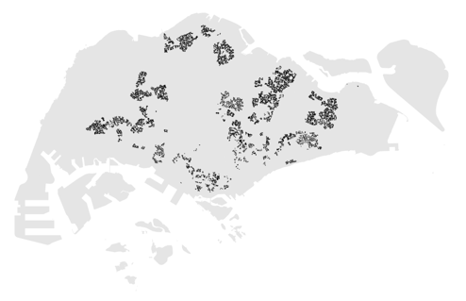
mapping where our hdb flats are onto a map of singapore
Our HDB living spaces coexists with private developments such as landed properties and condominiums. Thus, let’s visualise where our HDB flats are located on our island.

Slide 24
NOW
Pre-Processing and Modelling

Slide 25
REGRESSION MODELS
01
04
ELASTICNETCV
LINEAR
02
05
DECISION TREE
RIDGE & RIDGECV
03
06
LASSO & LASSOCV
RANDOM FOREST

Slide 26


WHAT ARE WE WORKING ON
LINEAR
(baseline)
DECISION TREE
RANDOM FOREST
R2 (Train) | 0.699
R2 (Test) | 0.698
MAE | $63413
RMSE | $84977
R2 (Train) | 0.999
R2 (Test) | 0.945
MAE | $23653
RMSE | $36178
R2 (Train) | 0.993
R2 (Test) | 0.968
MAE | $18736
RMSE | $27500

Slide 27
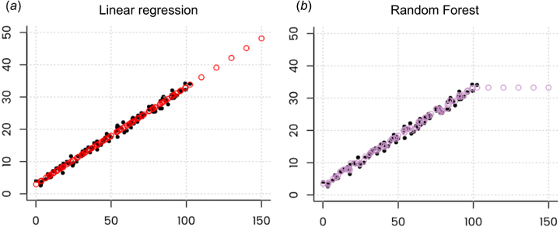
FUTURE IMPROVEMENTS
SVM
Stacking Regressors
Modified Versions of Random Forest (Regression-Enhanced Random Forests)
Random Forest Regression is a great model to find relationships between features and create predictions. However, it is not without its faults.
It is computationally expensive, but not as expensive as neural networks (deep learning).
It performs well on large datasets, and creates averages for missing values.
When predicting values within existing dataset (intrapolation), it is able to predict with an accuracy of 96.8%
However, it does poorly on extrapolation. For example, new types of HDB flats are being built (with new features) but insufficient data is available to predict resale price.
Read more on when Random Forest is not the best Regression Model: https://neptune.ai/blog/random-forest-regression-when-does-it-fail-and-why

Slide 28
APPLICATION
LAUNCH IN MAY 2022
Stay tuned @ HDBResaleFlatIG

Slide 29
THANK YOU
Our Instructors - Shilpa and Leo, for their never ending support and industrial knowledge
Our TAs - Mark, Jun Kai and Samuel, for their skills and abilities to help us debug
DSIF3 for being amazing bunch of people and sharing knowledge too!
Specifically for this project,
Jim Meng Kok - https://www.linkedin.com/in/jimmengkok/
Teoalida.com - having better explanations on HDB types and models better than HDB itself
SlidesGo - for the wonderful slides

